Slide 1

A Minor Project On FRAUDULENT PRODUCT DETECTION FOR DIGITAL EQUIPMENT BACHELOR OF TECHNOLOGY In COMPUTER SCIENCE AND ENGINEERING By SAI SINDHU D (197R1A05K4) VANGMAI KOHEDA (197R1A05P9) GAURAV MANDAL (197R1A05L1) Under the Guidance of V. NARESH KUMAR Assistant Professor

Slide 2
ABSTRACT
The availability of simulated products in the market is one of the biggest challenges of both the online and offline retail industry.
These products appear to be genuine but they are mocks of the original branded products affecting the company’s name, sales, and profit.
Block chain technology , used to identify real products and detect fake products, is a secured method ensuring that no block can be changed or hacked.
Quick Response (QR) codes provide a robust technique to fight the practice of counterfeiting the products.
Counterfeit products are detected using a QR code scanner, where a QR code of the product is linked to a Blockchain.
The central factor of using the block chain technology is to detect false products

Slide 3
EXISTING SYSTEM
There are other approaches based on improved communication between companies and organizations with the interest to reduce counterfeiting on the market - an example is React.
React is a not-for-profit organization providing a market, online and customs enforcement professional services.
Professional services approaches have a big advantage concerning accuracy but still working with the manual process and need manpower.
In the recent surveys, Counterfeiters are becoming more and more professional , they are using advanced approaches to bring the false products undetected into the market.
Consequently, overt and covert technologies can be easily imitated making difficult for the average end-consumer to distinguish between a convincing imitation and the real product.

Slide 4
DISADVANTAGES
Checking manually consumes a lot of time and human effort.
Not even experts can distinguish between an original and a fake product.
Tracking the products and segregating them is difficult.
It is a Centralized process.
Processes can be tampered.
It is not a dynamic process.

Slide 5
PROPOSED SYSTEM
We come up with a method to track every genuine digital device that is to be sold by the use of block chain technology.
Here, we add a QR code to them while the device is being manufactured, it will be linked to a Block chain.
Now we can store details and the QR code of the device in the form of blocks in the database.
People would be able to scan the QR code using their smart phones, where the scanned QR code is compared against the entries in the Block chain database.
This way, customers can be assured of the authenticity of the device.
In this system we implement our own tokens which can be sold to users so that they can purchase ownership of a device using tokens which helps in insurance processing.

Slide 6
ADVANTAGES
To track every genuine electronic device that is to be sold.
Virtual transactions
Using tamper-proof tags
Dynamic (read & write NFC tags)
QR codes which have secure graphic
Implement our own tokens which can be sold to users so that they can purchase ownership of a product using tokens which helps in insurance processing

Slide 7
HARDWARE REQUIRMENTS
Processor: Intel Celeron or higher, AMD Ryzen 3 2500U and above
RAM: 8GB and above
Space on Hard Disk: minimum 5GB
Smartphone with a built-in camera

Slide 8
SOFTWARE REQUIRMENTS
Android Studio – 2021.2.1.15
Java, HTML , XML
NodeJS - Server Environment
MySQL – Database
Block chain:
Ethereum - Block chain Network
Solidity - Smart Contracts
Ganache - Create private Ethereal block chain to run tests

Slide 9
NOVELTY
The approached solution has several improvements for the current anticounterfeiting technologies . It can be verified by average end-users, which can add a new protection layer to combat counterfeiting products.
In this project, Block chain technology is used for identification of real products and detects fake products.
Our solution provides a low-cost implementation, which is appropriate when the market is scaling up.
With our proposed solution , customers can be assured of the authenticity of devices without depending on third parties.

Slide 10
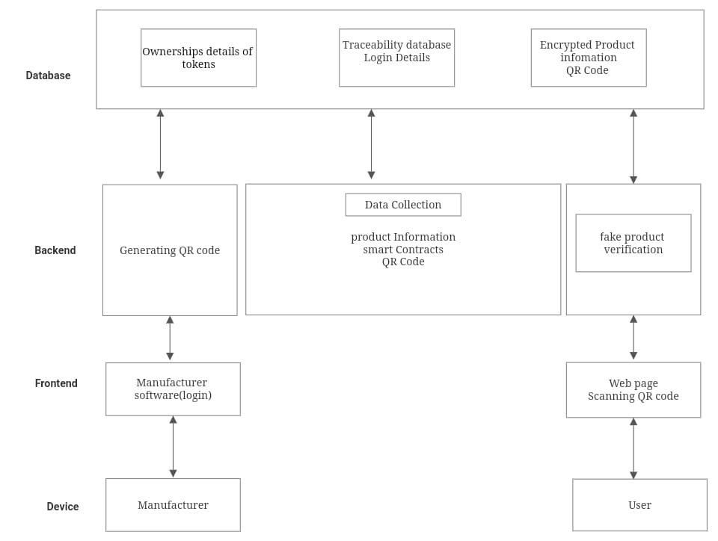
ARCHITECTURE

Slide 11
MODULES
Type of Logins:
Three Type of login.
Manufacturer, User and Admin.
Registration: User have to register to become a part of project.
Login: User have to login them self to access in project.
Add Product : After Manufacturer Login Manufacturer can add product using java script and smart Contract in Block chain Database.
Generate QR Code: All Product data display in admin side and admin verify that product and generate QR code of that related product using python and add in block chain database.
Scan QR Code: User Scan that QR code using Android Application And then Display All information of product in our mobile screen.

Slide 12
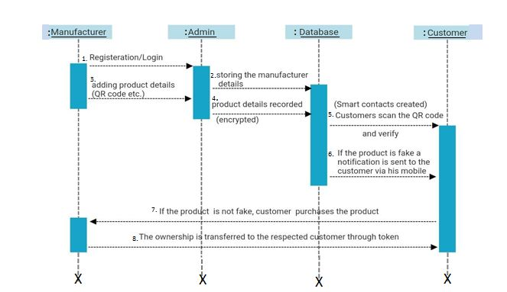
SEQUENCE DIAGRAM

Slide 13
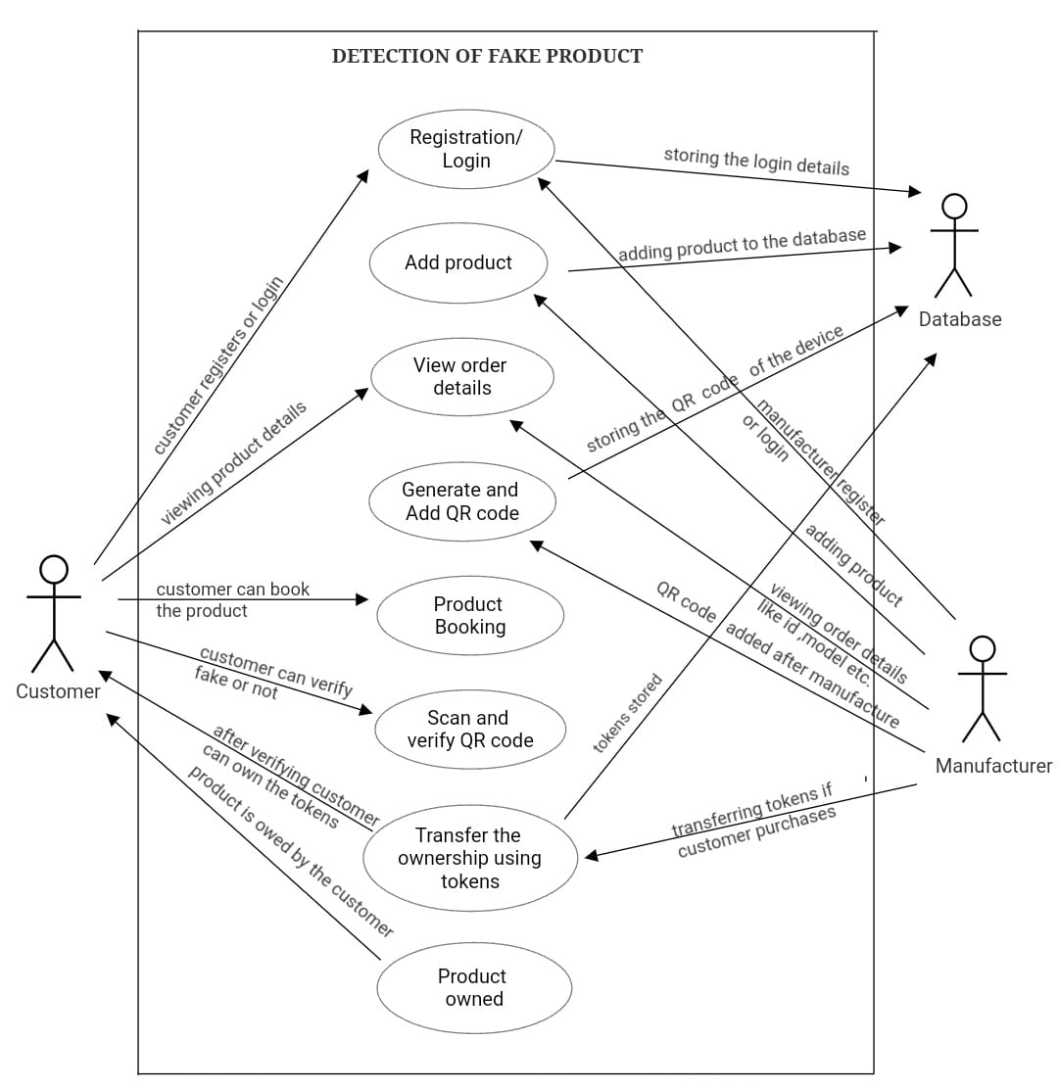
USE CASE DIAGRAM

Slide 14
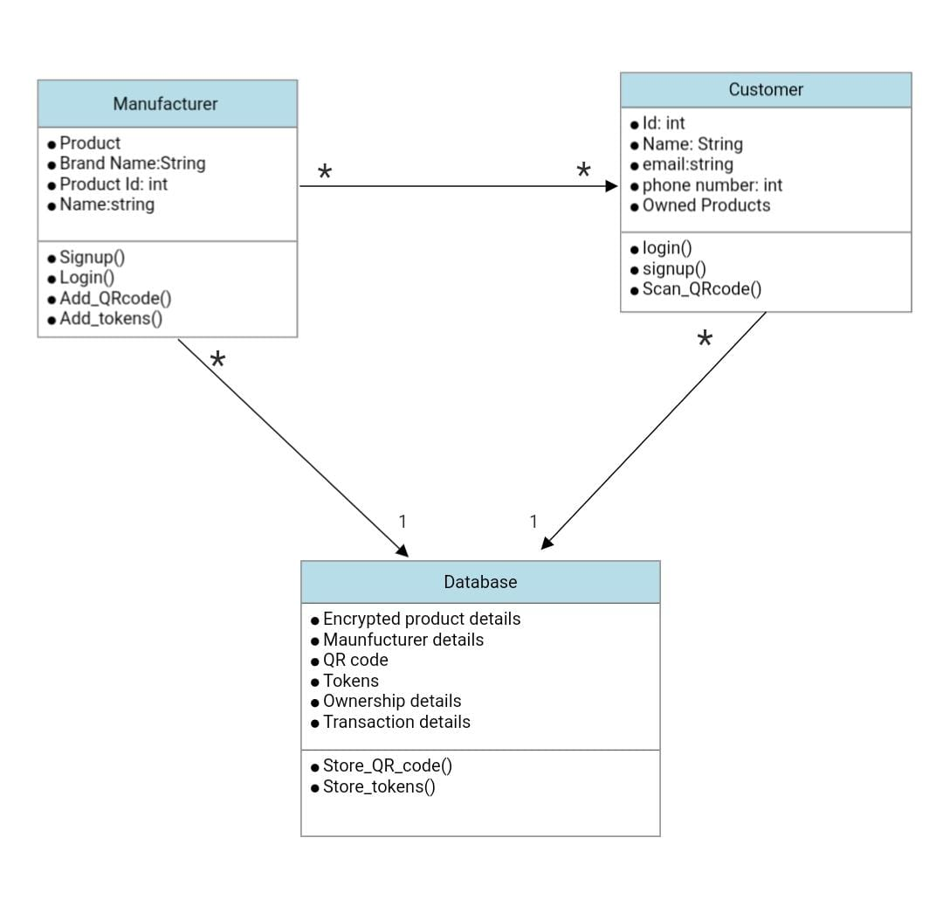
CLASS DIAGRAM

Slide 15
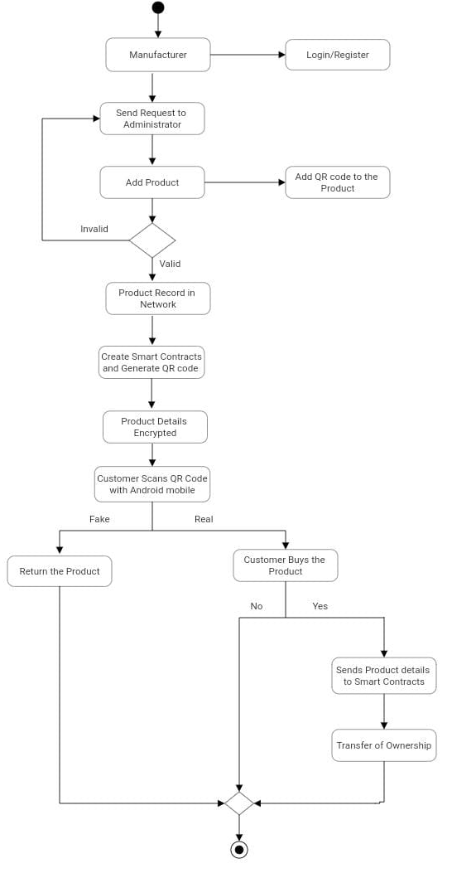
ACTIVITY DIAGRAM

Slide 16
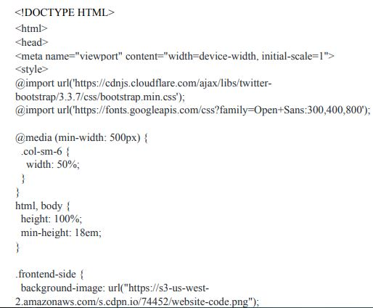
SAMPLE CODE

Slide 17
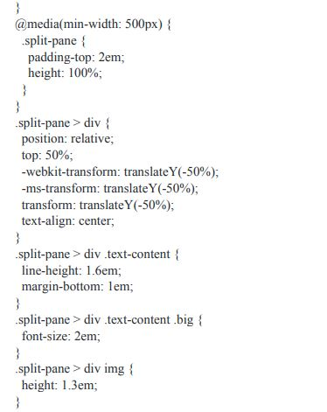
SAMPLE CODE

Slide 18
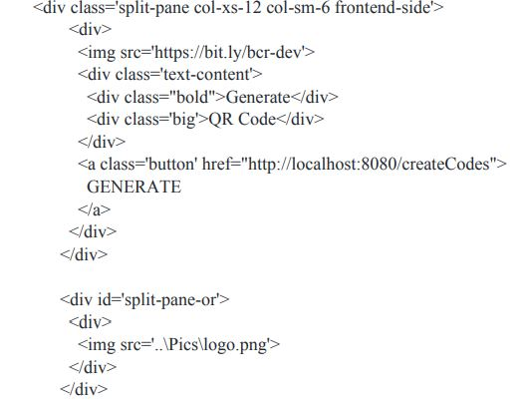
SAMPLE CODE

Slide 19
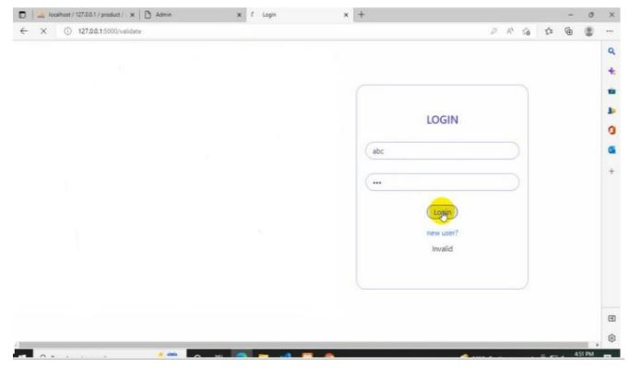
SCREENSHOTS
Admin Login

Slide 20
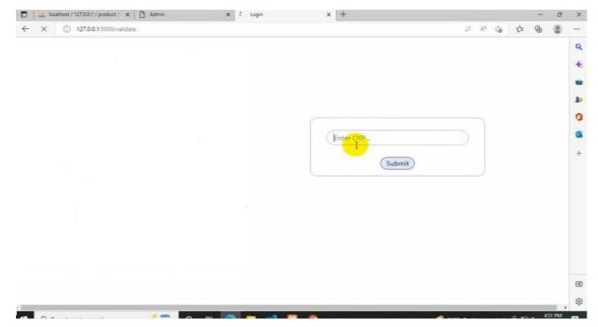
SCREENSHOTS
OTP Verification for registration Of user and manufacturer

Slide 21
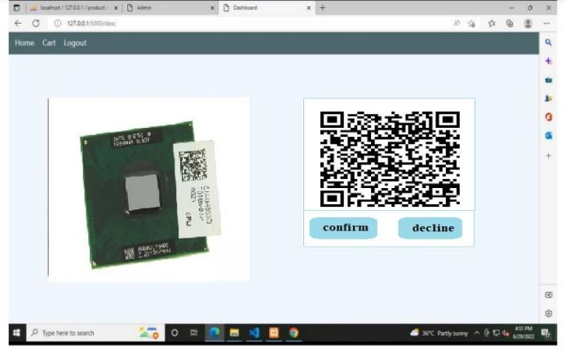
SCREENSHOTS
Verification of the product and confirmation of the purchase

Slide 22
CONCLUSION
In this project, we aim to detect false electronic devices. Furthermore, the information is encoded into a QR code.
Digital information of devices can be stored in the form of blocks in blockchain technology.
Thus, the proposed system is useful for the customer to detect fake devices in the supply chain.
Customers can scan QR codes assigned to a electronic device and can get all the information like transaction history, current-owner etc. based on which end-user can check whether the device is genuine or not.

Slide 23
FUTURE ENHANCEMENTS
The distributed system's code unpredictability directly affects the overall cost of running it on the Ethereum block chain.
Future usage of this system may demonstrate how simple the code is.
Due to the distributed application's simple design and lack of redundant code, the customer may be confident that it will not increase consumption.
Using Block chain technology to stop counterfeiting of the product could benefit the e-commerce companies as well as the customers.

Slide 24
REFERENCES
[1]. Miguel A. Prada-Delgado, Gero Dittmann, Ilie Circiumaru, Jens Jelitto “A block chain- based crypto-anchor platform for interoperable product authentication”, EEE International Symposium on Circuits and Systems (ISCAS),2021.
[2] Mrs S. Thejaswini, Ranjitha K R, “Block chain in Agriculture by using Decentralized Peer to Peer Networks”, Proceedings of the Fourth International Conference on Inventive Systems and Control (ICISC 2020),2020.
[3] Jinhua Ma, Shih-Ya Lin, Xin Chen, Hung-Min Sun, Yeh-Cheng Chen, and Huaxiong Wang, “A Block chain-Based Application System for Product Anti- Counterfeiting”, IEEE Acscess,2020.
[4] V. Buterin et al., “Ethereum white paper,” GitHub repository, 2013. G. Wood, “Ethereum: A secure decentralized generalised transaction ledger,” Ethereum project yellow paper, vol. 151, pp. 1–32, 2014.

Slide 25
GITHUB LINK
https://github.com/gauravmandal27/fraudulent-product-detection-blockchain

Slide 26
THANK YOU

